Slide 1
PL-SQL Concepts

Slide 2
PL/SQL
Procedural Language/Structured Query Language.
Programming Language.
Developed by Oracle Corporation in the late 1980s as procedural extension language for SQL and the Oracle relational database.
Completely portable, high-performance transaction-processing language.
Direct call can also be made from external programming language calls to database.

Slide 3
Features of PL/SQL
tightly integrated with SQL
Support for different data types.
Structured programming through functions and procedures.

Slide 4
Advantages of PL/SQL
SQL is the standard database language and PL/SQL is strongly integrated with SQL.
PL/SQL allows sending an entire block of statements to the database at one time. This reduces network traffic and provides high performance for the applications.

Slide 5
PL/SQL - Data Types
Data Type Category | Data Description
Scalar | Single values with no internal components.
Composite | Data items that have internal components that can be accessed individually.
Reference | Pointers to other data items. Explained in Using Cursor Variables (REF CURSORs).
Large Object (LOB) | Pointers to large objects that are stored separately from other data items, such as text, graphic images, video clips, and sound waveforms.

Slide 6
PL/SQL Numeric Data Types and Subtypes
S.No | Data Type & Description
1 | PLS_INTEGER Signed integer in range -2,147,483,648 through 2,147,483,647, represented in 32 bits
2 | BINARY_INTEGER Signed integer in range -2,147,483,648 through 2,147,483,647, represented in 32 bits
3 | BINARY_FLOAT Single-precision IEEE 754-format floating-point number
4 | BINARY_DOUBLE Double-precision IEEE 754-format floating-point number

Slide 7
5 | NUMBER(prec, scale) Fixed-point or floating-point number with absolute value in range 1E-130 to (but not including) 1.0E126. A NUMBER variable can also represent 0
6 | DEC(prec, scale) ANSI specific fixed-point type with maximum precision of 38 decimal digits
7 | DECIMAL(prec, scale) IBM specific fixed-point type with maximum precision of 38 decimal digits
8 | NUMERIC(pre, secale) Floating type with maximum precision of 38 decimal digits

Slide 8
9 | DOUBLE PRECISION ANSI specific floating-point type with maximum precision of 126 binary digits (approximately 38 decimal digits)
10 | FLOAT ANSI and IBM specific floating-point type with maximum precision of 126 binary digits (approximately 38 decimal digits)
11 | INT ANSI specific integer type with maximum precision of 38 decimal digits

Slide 9
12 | INTEGER ANSI and IBM specific integer type with maximum precision of 38 decimal digits
13 | SMALLINT ANSI and IBM specific integer type with maximum precision of 38 decimal digits
14 | REAL Floating-point type with maximum precision of 63 binary digits (approximately 18 decimal digits)

Slide 10
PL/SQL Character Data Types and Subtypes
1 | CHAR Fixed-length character string with maximum size of 32,767 bytes
2 | VARCHAR2 Variable-length character string with maximum size of 32,767 bytes
3 | RAW Variable-length binary or byte string with maximum size of 32,767 bytes, not interpreted by PL/SQL
4 | NCHAR Fixed-length national character string with maximum size of 32,767 bytes

Slide 11
5 | NVARCHAR2 Variable-length national character string with maximum size of 32,767 bytes
6 | LONG Variable-length character string with maximum size of 32,760 bytes
7 | LONG RAW Variable-length binary or byte string with maximum size of 32,760 bytes, not interpreted by PL/SQL

Slide 12
PL/SQL Datetime and Interval Types
The DATE datatype is used to store fixed-length datetimes, which include the time of day in seconds since midnight. Valid dates range from January 1, 4712 BC to December 31, 9999 AD.
The default date format is set by the Oracle initialization parameter NLS_DATE_FORMAT. For example, the default might be 'DD-MON-YY', which includes a two-digit number for the day of the month, an abbreviation of the month name, and the last two digits of the year. For example, 01-OCT-12.

Slide 13
Field Name | Valid Datetime Values | Valid Interval Values
YEAR | -4712 to 9999 (excluding year 0) | Any nonzero integer
MONTH | 01 to 12 | 0 to 11
DAY | 01 to 31 (limited by the values of MONTH and YEAR, according to the rules of the calendar for the locale) | Any nonzero integer
HOUR | 00 to 23 | 0 to 23
MINUTE | 00 to 59 | 0 to 59
SECOND | 00 to 59.9(n), where 9(n) is the precision of time fractional seconds | 0 to 59.9(n), where 9(n) is the precision of interval fractional seconds
TIMEZONE_HOUR | -12 to 14 (range accommodates daylight savings time changes) | Not applicable
TIMEZONE_MINUTE | 00 to 59 | Not applicable
TIMEZONE_REGION | Found in the dynamic performance view V$TIMEZONE_NAMES | Not applicable
TIMEZONE_ABBR | Found in the dynamic performance view V$TIMEZONE_NAMES | Not applicable

Slide 14
8 | ROWID Physical row identifier, the address of a row in an ordinary table
9 | UROWID Universal row identifier (physical, logical, or foreign row identifier)

Slide 15
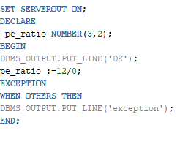
Block Structure
SET SERVEROUT ON;
DECLARE
pe_ratio NUMBER(3,2);
BEGIN
DBMS_OUTPUT.PUT_LINE('DK');
pe_ratio :=12/0;
EXCEPTION
WHEN OTHERS THEN
DBMS_OUTPUT.PUT_LINE('exception');
END;

Slide 16
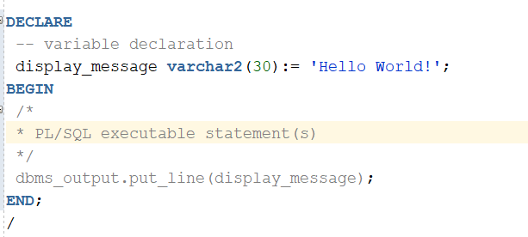
The PL/SQL Comments

Slide 17
Function
CREATE [OR REPLACE] FUNCTION function_name
[(parameter_name [IN | OUT | IN OUT] type [, ...])]
RETURN return_datatype
{IS | AS}
BEGIN
< function_body >
END [function_name];

Slide 18
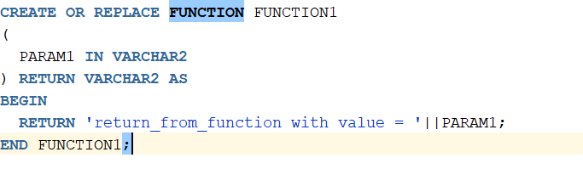
Example

Slide 19
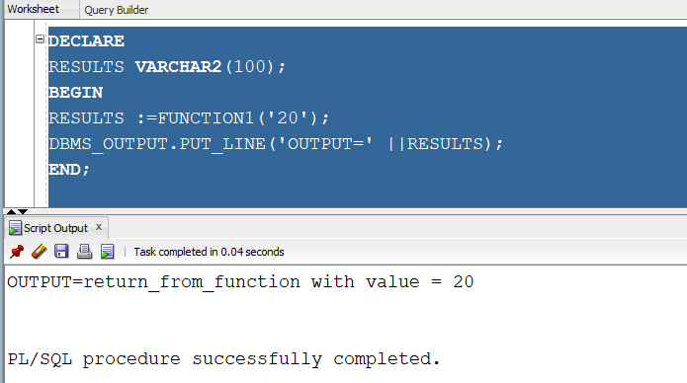
Output:

Slide 20
Procedure
CREATE OR REPLACE PROCEDURE PROCEDURE_TEST
(
PARAM1 IN NUMBER
, PARAM2 IN NUMBER
, PARAM3 OUT NUMBER
) AS
BEGIN
DBMS_OUTPUT.PUT_LINE('In the Proceduere');
PARAM3 := PARAM1+PARAM2;
DBMS_OUTPUT.PUT_LINE(PARAM3);
END PROCEDURE_TEST;

Slide 21
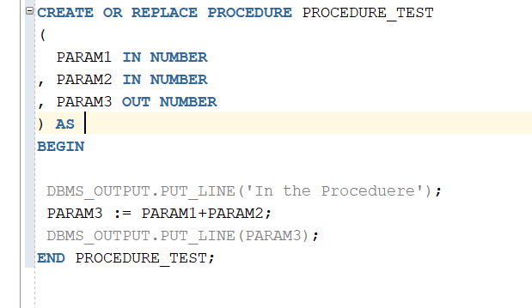
Example

Slide 22
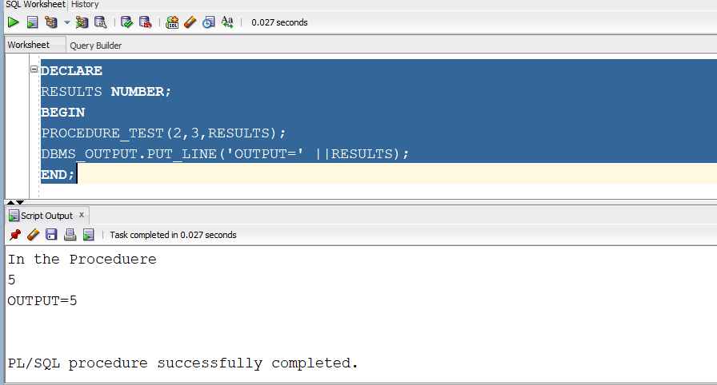
Output:

Slide 23
PL/SQL - Cursors
A cursor is a pointer to this context area.
PL/SQL controls the context area through a cursor.
A cursor holds the rows (one or more) returned by a SQL statement. The set of rows the cursor holds is referred to as the active set.

Slide 24
Types of Cursors
Implicit cursors
Explicit cursors

Slide 25
Implicit Cursors
Created by Oracle whenever an SQL statement is executed.

Slide 26
S.No | Attribute & Description
1 | %FOUND Returns TRUE if an INSERT, UPDATE, or DELETE statement affected one or more rows or a SELECT INTO statement returned one or more rows. Otherwise, it returns FALSE.
2 | %NOTFOUND The logical opposite of %FOUND. It returns TRUE if an INSERT, UPDATE, or DELETE statement affected no rows, or a SELECT INTO statement returned no rows. Otherwise, it returns FALSE.
3 | %ISOPEN Always returns FALSE for implicit cursors, because Oracle closes the SQL cursor automatically after executing its associated SQL statement.
4 | %ROWCOUNT Returns the number of rows affected by an INSERT, UPDATE, or DELETE statement, or returned by a SELECT INTO statement.

Slide 27
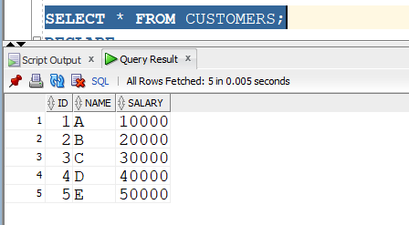
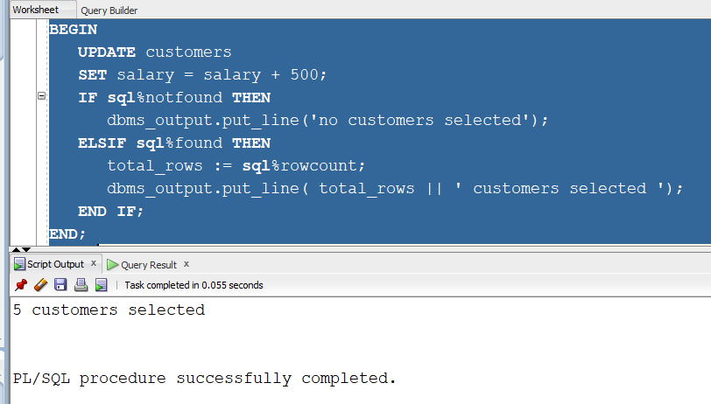
Example
DECLARE
total_rows number(2);
BEGIN
UPDATE customers
SET salary = salary + 500;
IF sql%notfound THEN
dbms_output.put_line('no customers selected');
ELSIF sql%found THEN
total_rows := sql%rowcount;
dbms_output.put_line( total_rows || ' customers selected ');
END IF;
END;

Slide 28
Explicit Cursors
programmer-defined cursors for gaining more control over the context area.
An explicit cursor should be defined in the declaration section of the PL/SQL Block. It is created on a SELECT Statement which returns more than one row.
CURSOR cursor_name IS select_statement;

Slide 29
Steps:
Declaring the cursor for initializing the memory
Opening the cursor for allocating the memory
Fetching the cursor for retrieving the data
Closing the cursor to release the allocated memory

Slide 30
Declaring the Cursor:
CURSOR c_customers IS
SELECT id, name, address FROM customers;
Opening the Cursor:
Allocates the memory for the cursor and makes it ready for fetching the rows returned by the SQL statement
OPEN c_customers;
Fetching the Cursor:
FETCH c_customers INTO c_id, c_name, c_addr;
Closing the Cursor:
CLOSE c_customers;

Slide 31
Example
DECLARE
c_id customers.id%type;
c_name customers.Name%type;
CURSOR c_customers is
SELECT id, name FROM customers;
BEGIN
OPEN c_customers;
LOOP
FETCH c_customers into c_id, c_name;
EXIT WHEN c_customers%notfound;
dbms_output.put_line(c_id || ' ' || c_name);
END LOOP;
CLOSE c_customers;
END;

Slide 32
